Slide 1
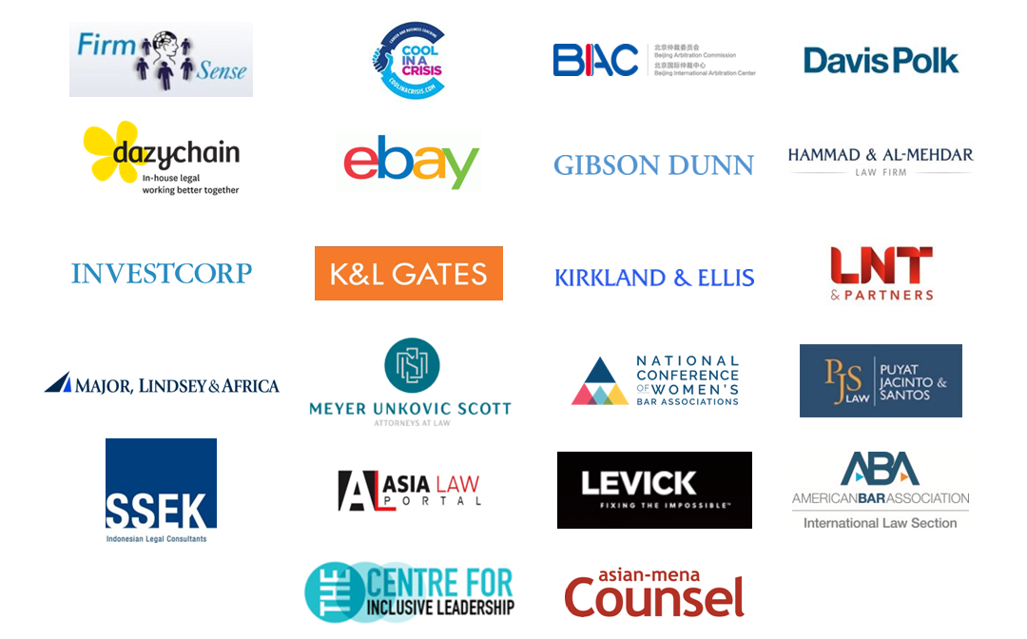
IS COVID-19 TAKING WOMEN LAWYERS’ CAREERS BACK TO THE 1950's?
With thanks to our ‘Women in Law’ Dialogue Supporters*:

Slide 2
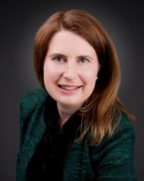
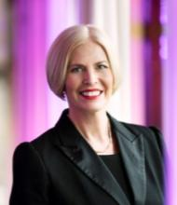
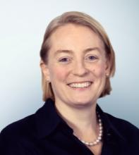
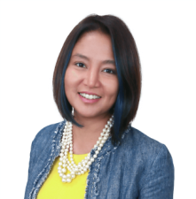
Sally Dyson, consultant and coach to the legal profession at Firm Sense, former Head of Group Compliance & Regulation, Travelex Group and Co-Author of ‘The Real Deal: Law Firm Leadership that Works’
Christina Blacklaws, Consultant, Blacklaws Consulting Ltd., former President, Law Society of England & Wales
Georgia Dawson, Asia Regional Managing Partner, Freshfields Bruckhaus Deringer
Hanim Hamzah, Regional Managing Partner – ASEAN, ZICOLaw

Slide 3
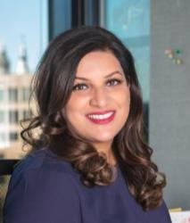
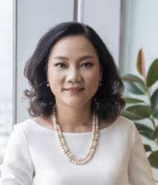
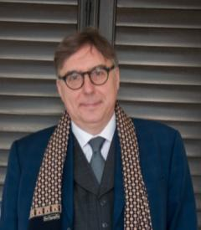
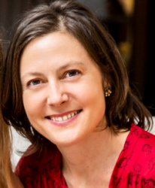
Neelam Kaul, Founder, “Stressed in the City”, Global Executive Career Coach
Nguyen Ha Quyen Hoang, Founding and Managing Partner, LNT & Partners
Patrick Dransfield, Co-Director, In-House Community
Serena Wallace-Turner, COO, Radiant Law

Slide 4
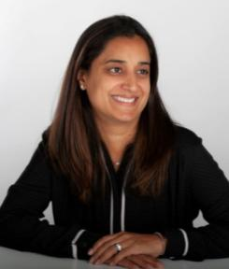
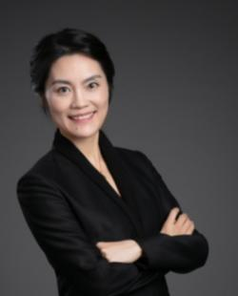
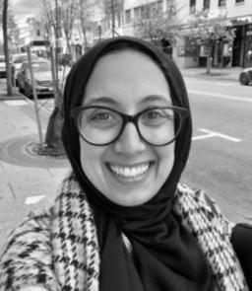
Shruti Ajitsaria, Partner, Allen & Overy and Head of FUSE
Wei Wen Wang, Vice President, Intercontinental Hotels Group, Greater China
Yosr Hamza, Director, Legal Counsel, Gartner

Slide 5
21,000+ In-House Counsel across

Slide 6
In-House Community Attendees in 2019 Overall Percentage between Male & Female
2, 450 In-House Community attendees in 2019
EMBARGO © 2020 In-House CommunityTM

Slide 7
In-House Community General Counsel in 2019 Overall Percentage between Male & Female
1,101 General Counsel attendees in 2019
EMBARGO © 2020 In-House CommunityTM

Slide 8
Covid-19 and Liminality*
Choices for the future –
a. ‘nationalist routes’
b. forging a better shared future
Social & Economic Impact – rising joblessness & economic impact
Immediate Impact: Fear, Illness, Death
Indirect health results – missed cancer, unintended consequences
*The Liminal Stage is where participants stand at a threshold between their previous way of structuring their identity, time and / or community, and a new way…..

Slide 9
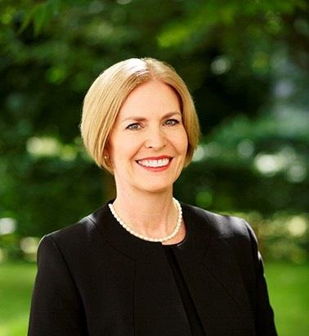
Women in Law
Christina Blacklaws
Immediate Past President of the Law Society of England and Wales
Leader, NED, consultant and speaker
Advisory Board of Thompson Reuters Women in Leadership; Advisory Board of 20-First
@blacklawslaw
christina@blacklawsconsulting.com
07714230852

Slide 10
Disparity at leadership level
Solicitors
Partners

Slide 11
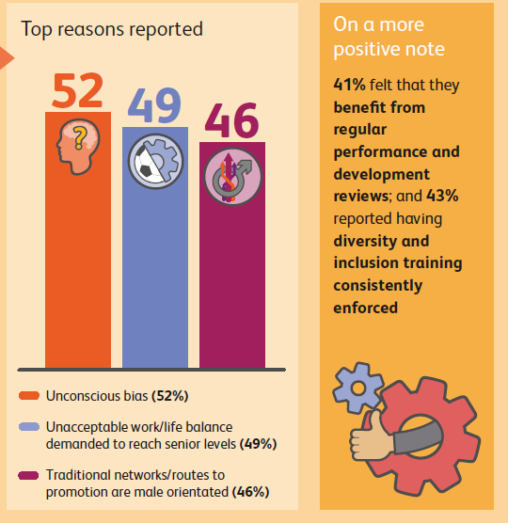

Slide 12
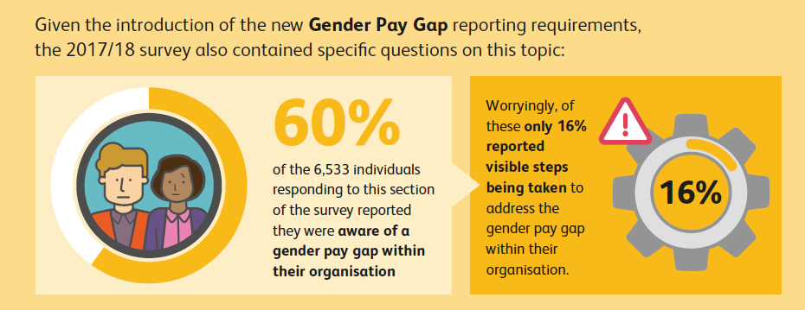

Slide 13
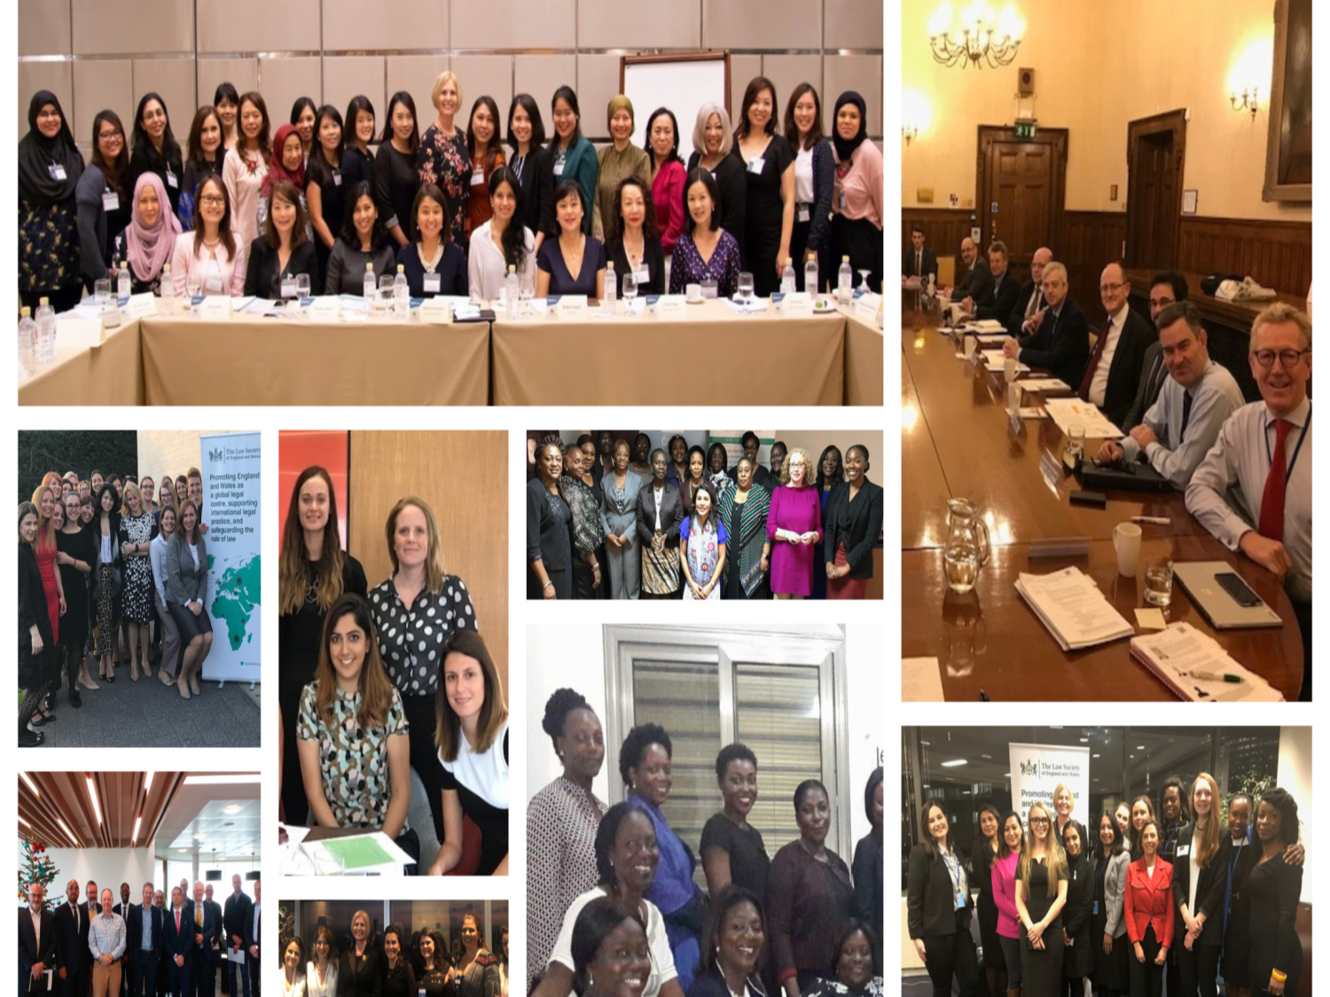

Slide 14
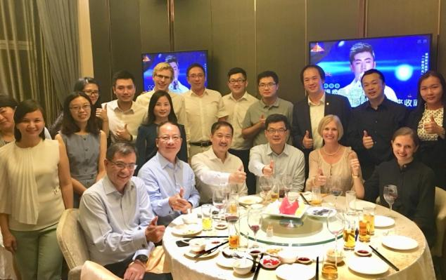
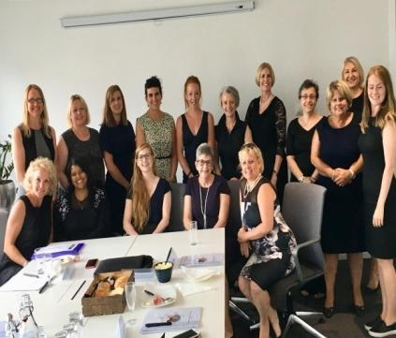
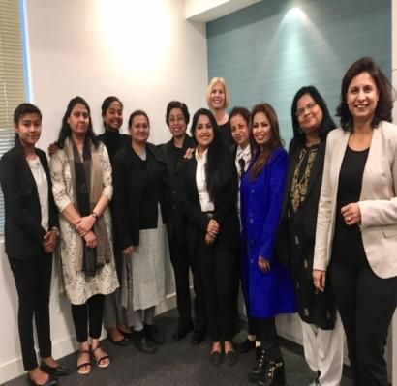
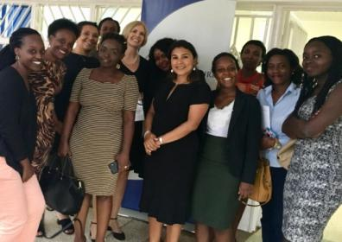
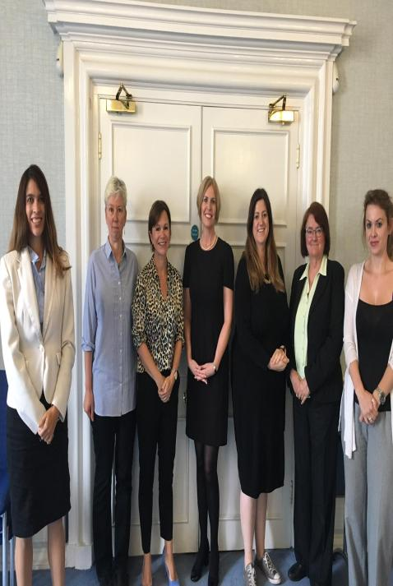
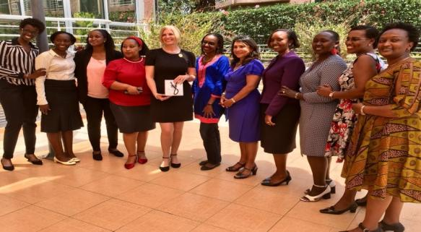
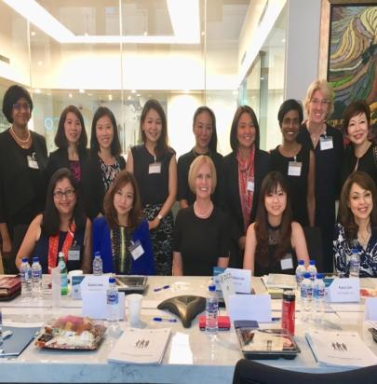
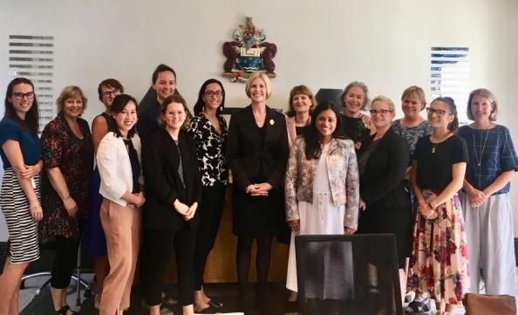

Slide 15
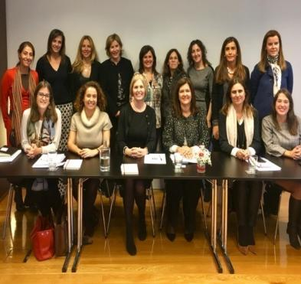
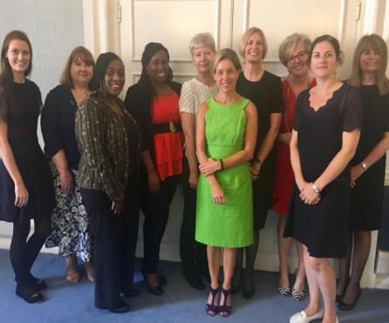
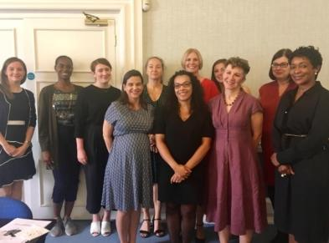
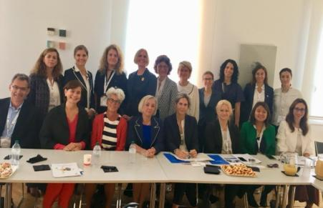
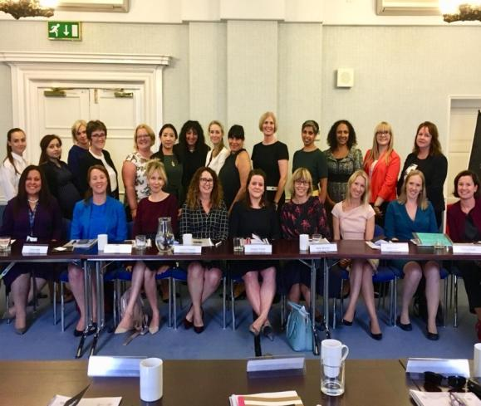
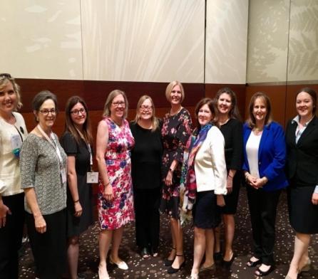

Slide 16
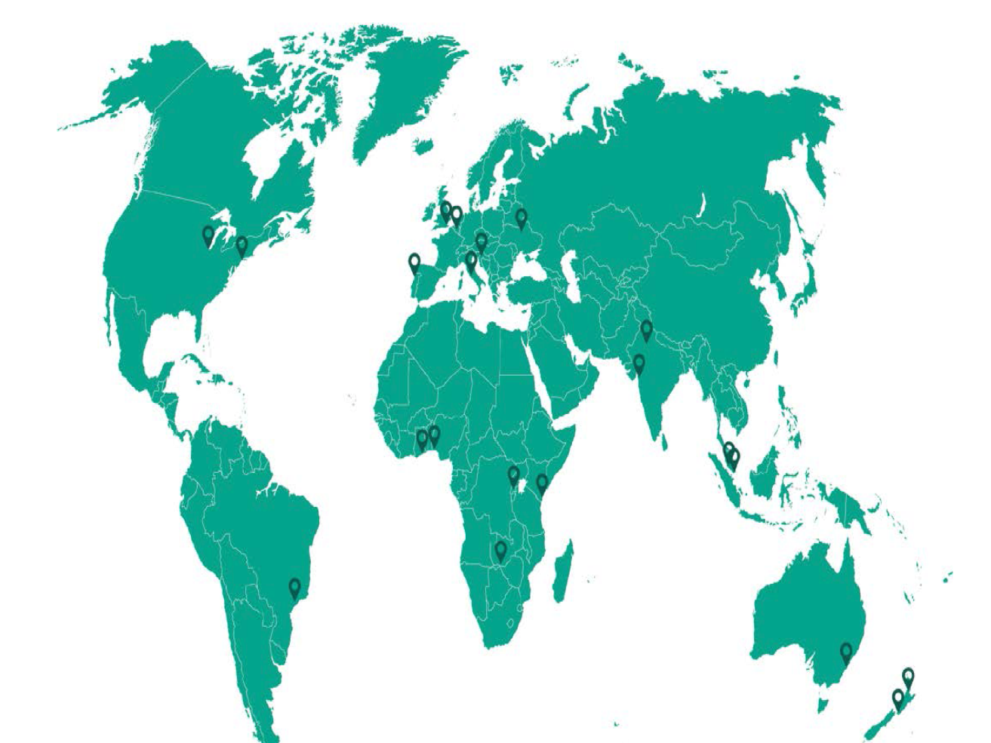
Women in Law roundtables

Slide 17
Toolkits

Slide 18
Research findings

Slide 19
Insights from domestic women’s roundtables
Not fitting into the traditional image of a business leader – which tends to favour characteristics that are traditionally ‘male’.
Significant under representation at leadership levels.
Assumptions impacting development and promotion
Intersectionality affecting women with more than one protected characteristic.

Slide 20
Insights from domestic men’s roundtables
Women are significantly under-represented in senior positions.
This imbalance has led to a larger gender pay gap, mainly but not exclusively, due to the small percentage of women in senior leadership roles
There needs to be a focus on female promotion and success planning.
Equal opportunities are needed to ensure women are involved in high profile work ,to gain suitable experience and credibility needed for promotion.

Slide 21
Insights from international roundtables
The challenges and experiences of female lawyers are very similar across the globe.
Shared experiences in relation to traditional gender roles and stereotypes, gender pay disparity and the lack of flexible working.
Particularly, working mothers seem to be penalised for their additional care giving commitments outside of work.
Lack of transparency about financial compensation across all regions. This prevents the identification of pay discrepancies and accountability.

Slide 22
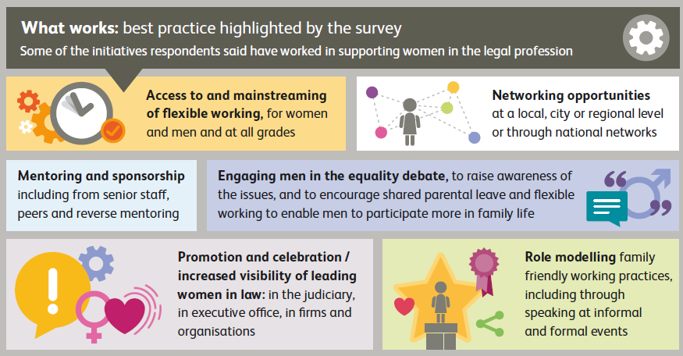
Solutions highlighted in our survey

Slide 23
Solutions
Supportive and engaged leadership
Prioritising diversity in business planning
Greater transparency
Consistent training to eliminate bias
Assess recruitment and selection policies
Gender champions, bystander training and balanced decision making boards
Make flexible working available to all

Slide 24
Blueprint for Gender Balance

Slide 25
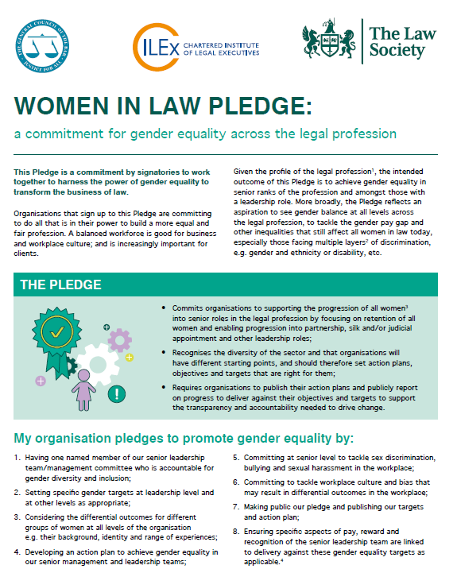
Women in Law Pledge & Guidance

Slide 27
Thank you! Any questions?
Christina Blacklaws
Immediate Past President of the Law Society of England and Wales
Leader, NED, consultant and speaker
Advisory Board of Thompson Reuters Women in Leadership; Advisory Board of 20-First
@blacklawslaw
christina@blacklawsconsulting.com
07714230852

Slide 28
Patrick Dransfield, Co-Director, In-House Community
Patrick is Co-Director of the In-House Community, wholly owned by Pacific Business Press and has twenty-two years of experience working in the legal industry: as Asia Managing Director of Euromoney Institutional Investor, and then as Marketing and Business Development Director for Asia for Shearman & Sterling and White & Case respectively. Patrick joined Pacific Business Press in 2008. His publishing career began with Haymarket Publishing in 1987. Patrick is a graduate of Leeds University and also holds a Master’s Degree in Far East Area Studies from the School of Oriental & African Studies (London University SOAS). Patrick is included in the 30 people to watch in the business of law in Asia 2019 by Asia Law Portal.

Slide 29
Sally Dyson, consultant and coach to the legal profession at Firm Sense, former Head of Group Compliance & Regulation at Travelex Group and Co-Author of “The Real Deal: Law Firm Leadership that Works.”

Slide 30
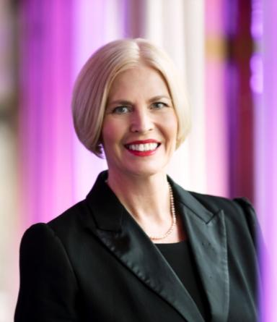
Christina Blacklaws, Consultant, Blacklaws Consulting Ltd., former President, Law Society of England & Wales
Christina is the immediate past president of the Law Society of England and Wales, chairs two U.K. government panels in LawTech and advises global business as a strategic consultant and NED. She is an expert in diversity and inclusion.

Slide 31
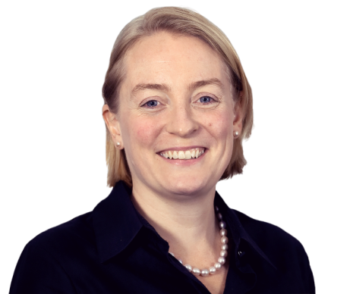
Georgia Dawson, Asia Regional Managing Partner, Freshfields Bruckhaus Deringer

Slide 32
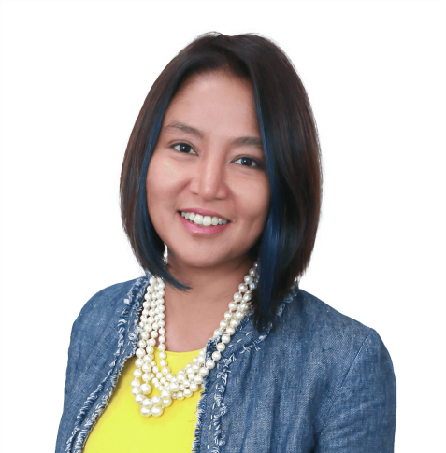
Hanim Hamzah, Regional Managing Partner – ASEAN, ZICOLaw
Hanim Hamzah is the Regional Managing Partner of the ZICO Law network and heads the Corporate M&A practice group at ZICO Law’s Indonesia office, Roosdiono & Partners. Her 24 years of regional practice experience includes being resident in Malaysia, Japan, Indonesia and Singapore where she specialises in major infrastructure project financing and M&A deals in aviation, banking, insurance, mining, oil and gas, plantations, and property. Hanim is top ranked and recognized across multiple practice areas in the major legal directories and is recognized as one of Financial Times’ ten pioneers of new legal thinking at the Asia-Pacific Innovative Lawyers. She is currently Senior Vice-Chair of the International Bar Association Law Firm Management Committee and Senior Fellow at the CIMB Asean Research Institute (CARI). Recently, Hanim has been selected by the Singapore Academy of Law, as part of an expert think-tank to prepare a white paper on skills needed by legal professionals in the future. The paper is due to be published in 2020.
She is also a marathoner and sings in a jazz quartet.

Slide 33
Neelam Kaul, Founder, “Stressed in the City”, Global Executive Career Coach
Neelam is the founder of Stressed In the City, a Global Executive Coaching and Training company. She runs workshops and webinars for corporates and leading UK universities.

Slide 34
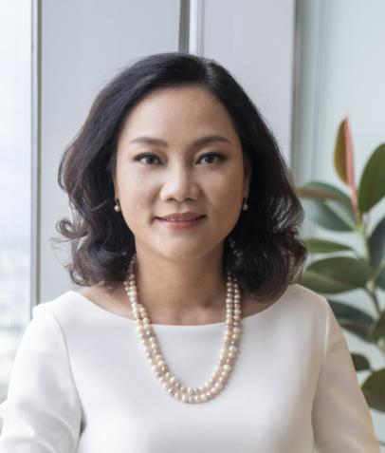
Nguyen Ha Quyen Hoang, Founding and Managing Partner, LNT & Partners
Quyen is in charge of the firm’s Corporate and M&A practice group. She has been ranked by Chambers as a Corporate/M&A expert, and recently being voted as Commended External Counsel of the Year 2020 by In-house Community

Slide 35
Serena Wallace-Turner, COO, Radiant Law
Serena is a director of Radiant Law, a UK-based award winning NewLaw firm leading the way in supporting businesses to accelerate their commercial contracting through people, process and technology.

Slide 36
Shruti Ajitsaria, Partner, Allen & Overy and Head of FUSE
Shruti is Head of Fuse, A&O’s tech innovation space. Fuse identifies legaltech, regtech and dealtech companies relevant to A&O lawyers, their clients and to find ways to start working together.

Slide 37
Wei Wen Wang, Vice President, Intercontinental Hotels Group, Greater China

Slide 38
Yosr Hamza, Director, Legal Counsel, Gartner
Yosr is a multi-award winning experienced legal counsel with both a private practice and in-house background. She is currently the leading legal director for the Middle East in Gartner. Embracing Gartner’s Principles of Independence and Objectivity, She also supports the Gartner Office of the Ombudsman. She is passionate about the empowerment of women and further the advancement of women rights to achieve gender equity.

Slide 39
IS COVID-19 TAKING WOMEN LAWYERS’ CAREERS BACK TO THE 1950's?
With thanks to our ‘Women in Law’ Dialogue Supporters*:

